Slide 1
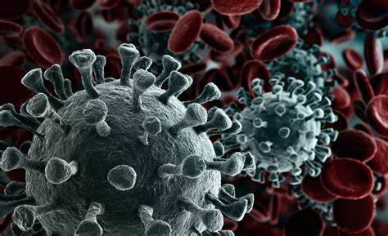
Covid19 Case Data within the United States
by Sabrina Reed
Jabin Barcelo
William Tate

Slide 2
The focus of this project is to discuss the impact COVID 19 has on the United States and several industries stocks prices.
We will discuss:
What are the number of cases in America over time? Did the virus have an impact on each state? At any point of the year, did number start to decrease? What was the impact to the travel, hospitality, sports? What impact has it on the pharmaceutical industry’s stocks?

Slide 3

What are the number of cases in America over time?

Slide 4
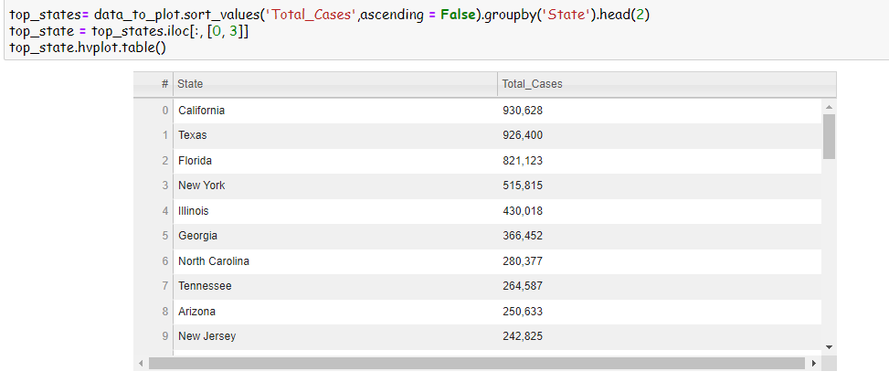
To discover the significance of how COVID-19 has impacted the US, we collected data from the CDC to show the top 10 states with the highest number of COVID-19 Cases.

Slide 5
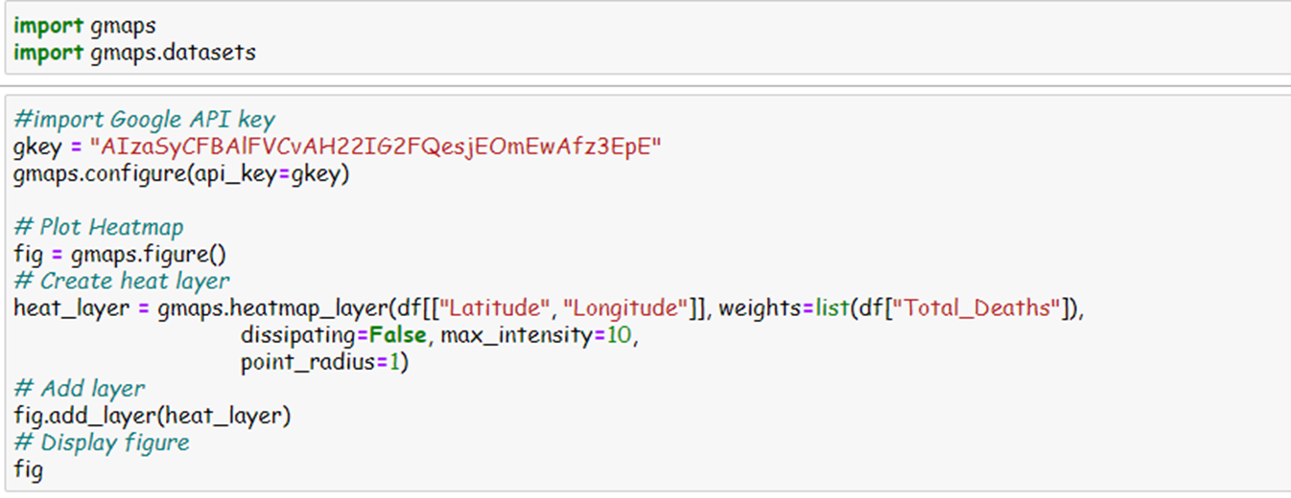
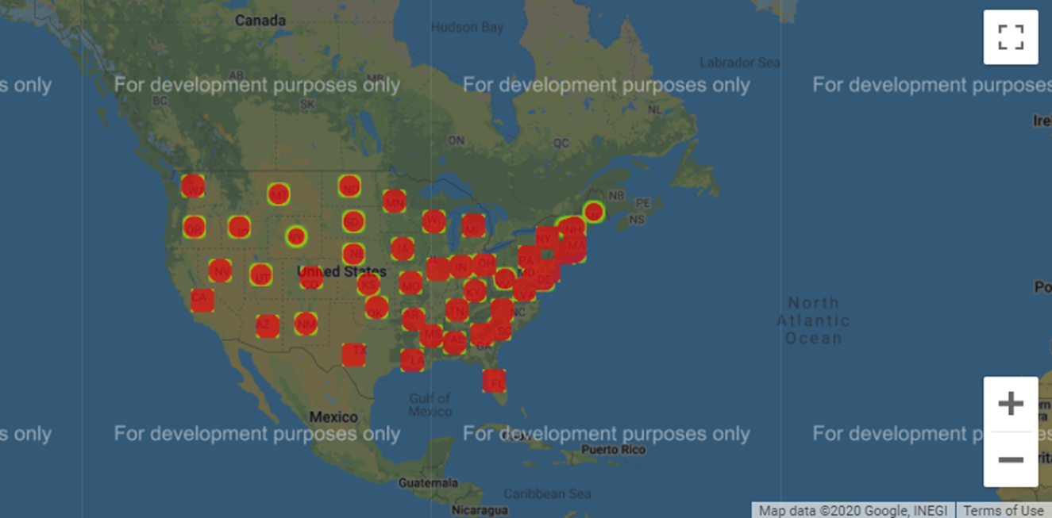
Using Gmaps, a google python library, to create a heat layer map to show the magnitude of the total deaths of each state.

Slide 6
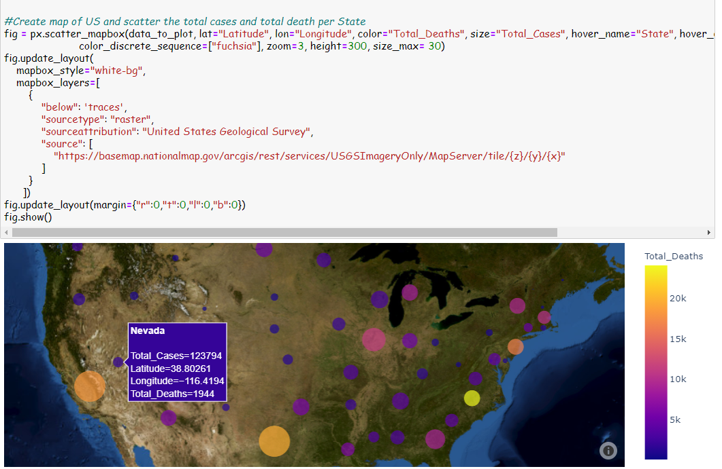
Here we plotted the number cases and deaths to each state. As you can see, the bigger the bubble, the more cases are in that state.

Slide 7
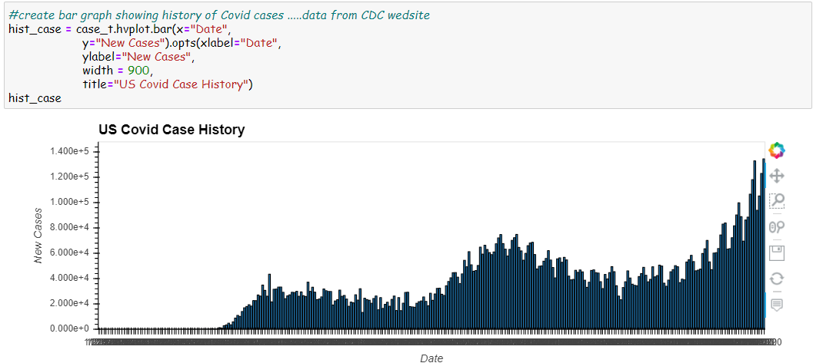
This graph shows the number of cases from the beginning of the year to the 11/4/2020. January 22, the country discovered it’s first case of COVID, by March 3, 2020, more and more cases we discovered in different locations. According to the CDC website, before the summer, cases were dropping. States started to mandate CDC recommendation and closing bars, gyms, movie theaters, and more. In the month of July, cases again start to spike due to reduction in restrictions. States once again went back on lockdown and number decreased again. Today, cases are increasing everyday. The United States lead in number of cases throughout the world.
March 3, 2020

Slide 8
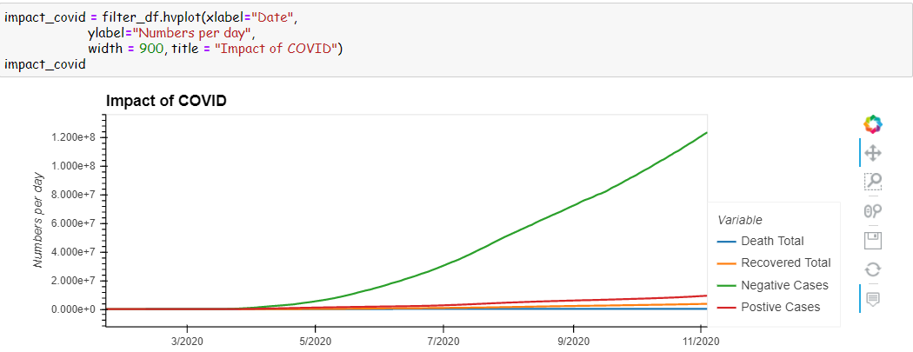
Below is a graph that shows a correlation between the deaths from COVID, the recovery cases and whether the cases were negative or positive.

Slide 9

Airlines

Slide 10
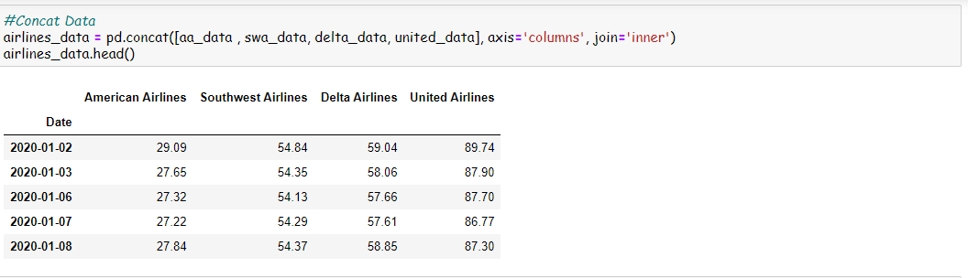
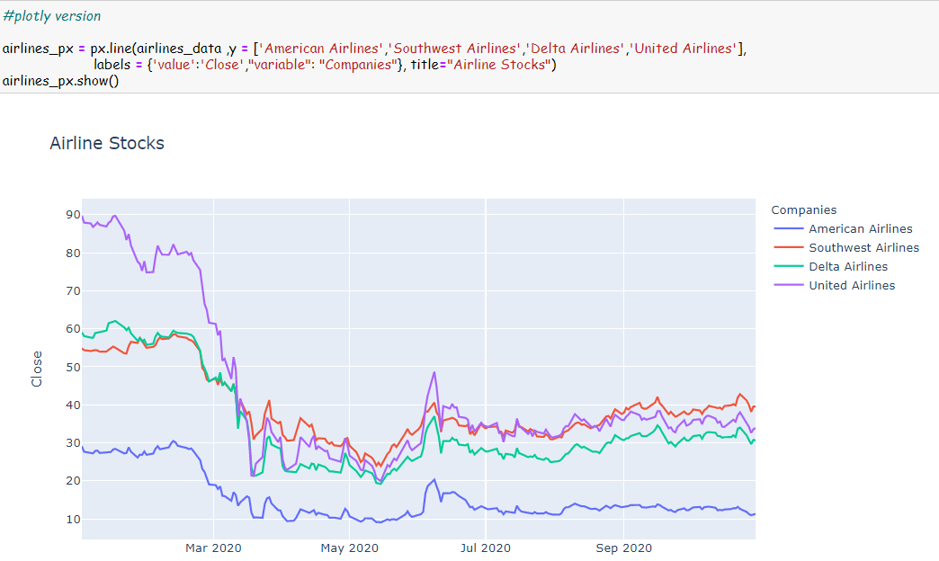

Slide 11

Hospitality

Slide 12
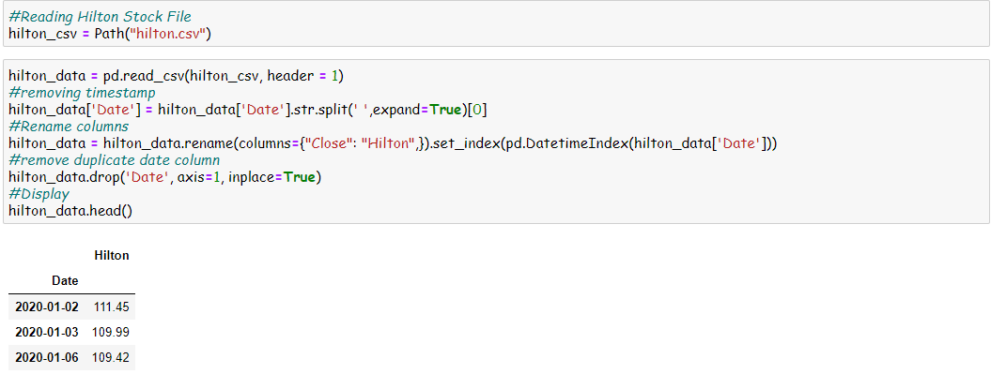

Slide 13
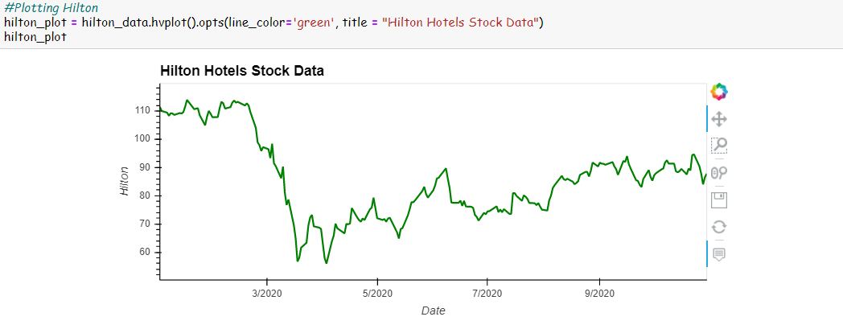

Slide 14
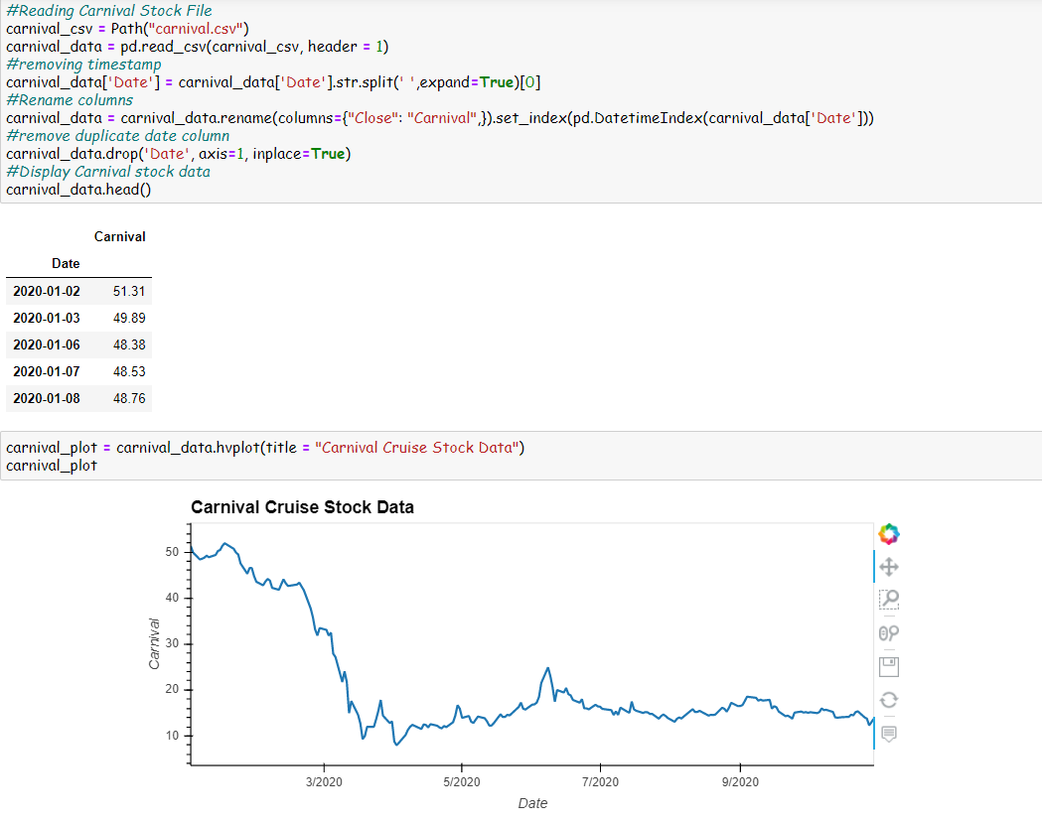

Slide 15
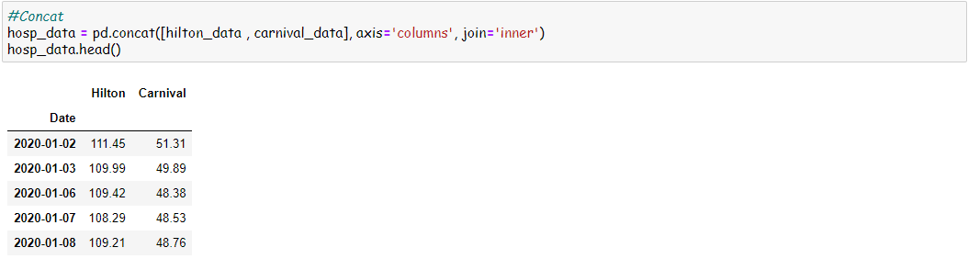
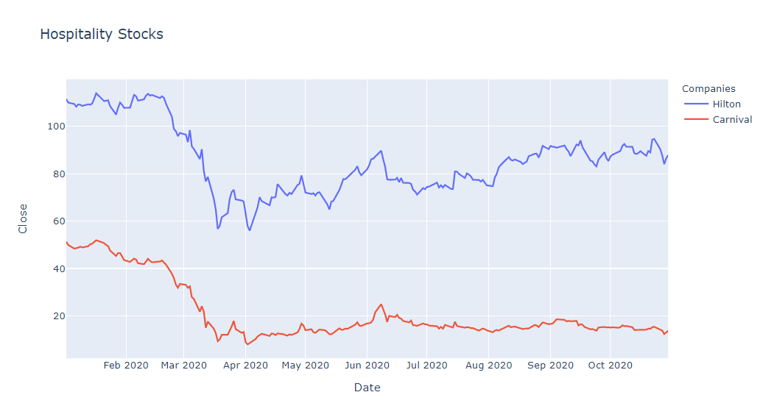

Slide 16
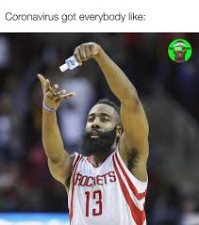
Sports

Slide 17
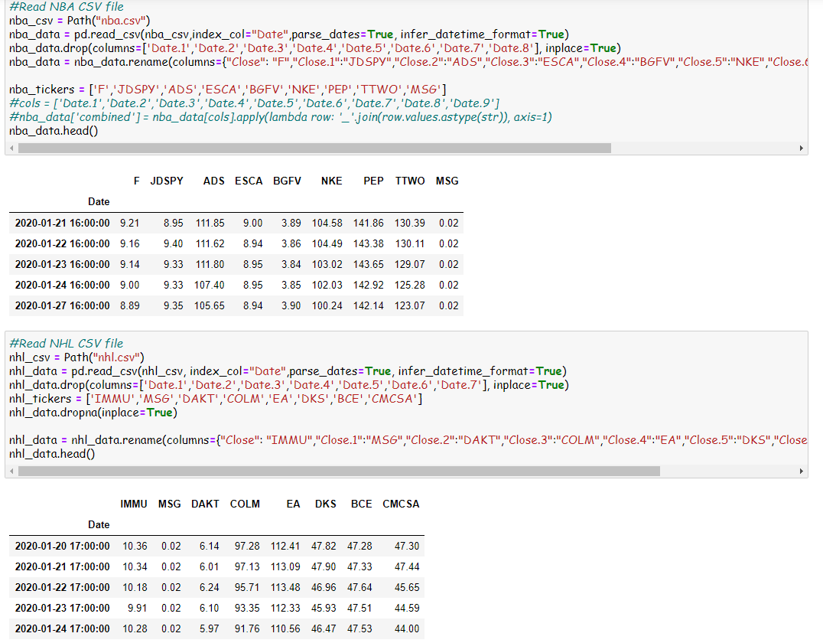

Slide 18
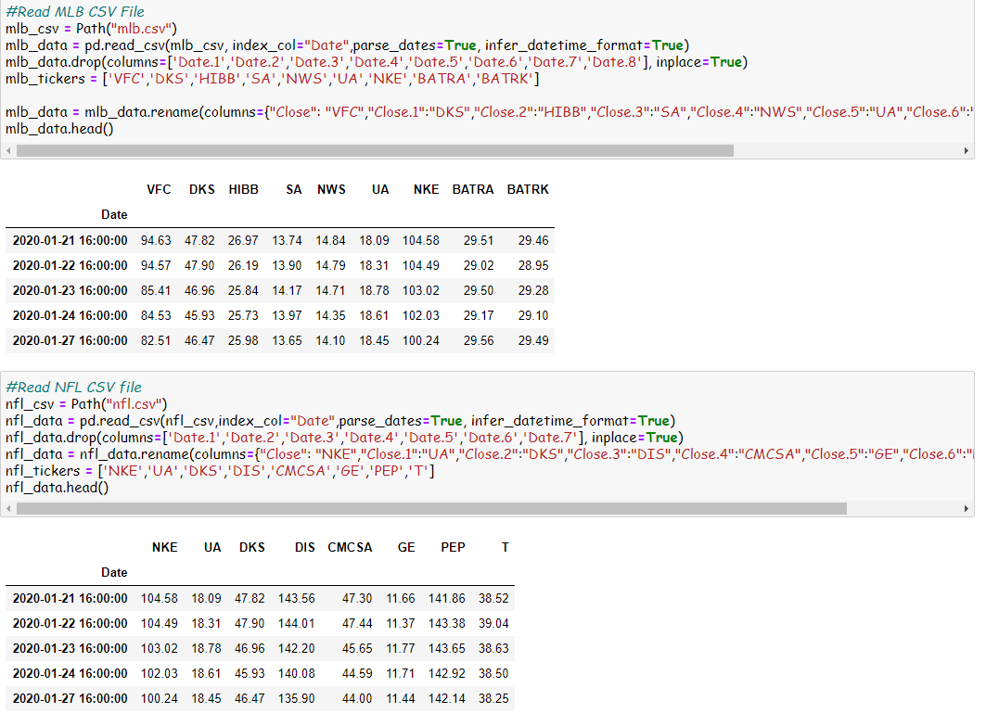

Slide 19
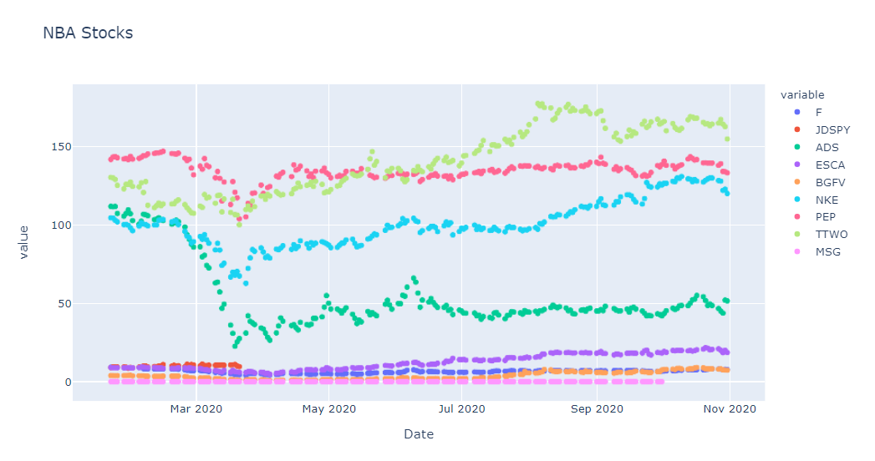

Slide 20
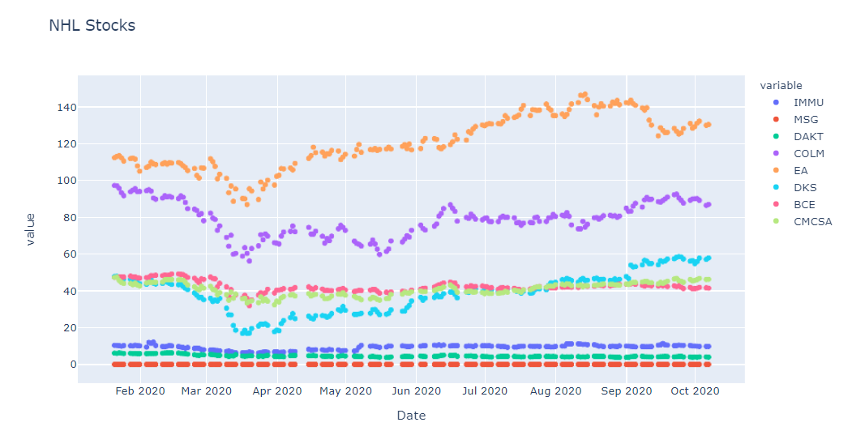

Slide 21
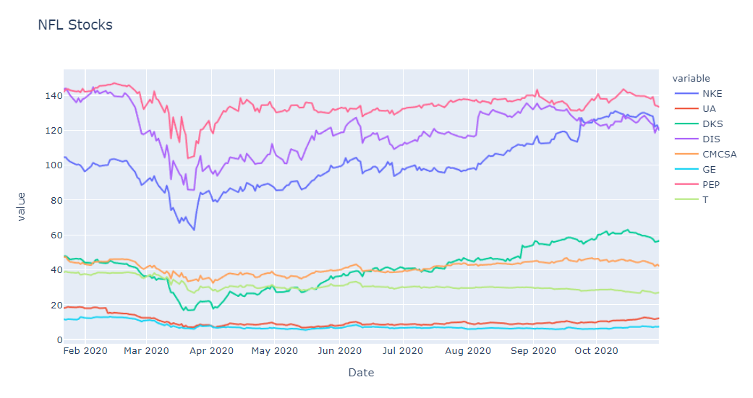

Slide 22
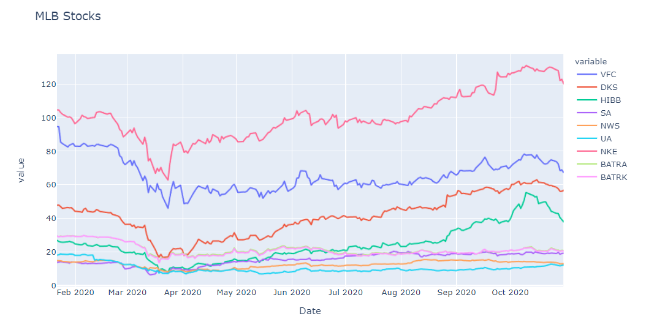

Slide 23
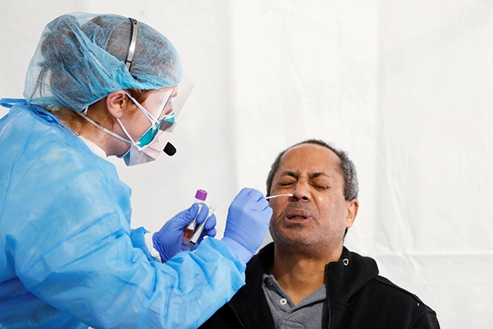
Vaccinations

Slide 24
